Slide 1
Laravel Course

Slide 2
Overview
This course gives an introduction to Laravel framework for PHP
This course touches fundamental topics of Laravel and also gives practical project like developing a simple crud application

Slide 3
Module 1
This module gives an overview of Laravel framework like its
1. Usage – For developing website through php which are scalable and maintainable
2. Advantages in using it – Easy syntax with scalable and maintainable code structure
Large communities
Modern Features like eloquent ORM for database interactions
Blade templating for views
3. Introduction to MVC architecture – Model, View, Controller Architecture for code structure

Slide 4
Module 2
This module covers lesson for developing a simple crud application using Laravel, it covered following topics
Creating Active records – Allows to work with database using an object-oriented approach
Working with view – The view handles how the data will be represented to the user. It is made by using blade templating
Working with controller – It is the middleman between model and view
Routing – Handling http requests

Slide 5
Key Features
Eloquent ORM – For interaction with database with the help of active record pattern
MVC Architecture – Follows Model, View and Controller architecture which make the application scalable and maintainable
Blade Templating – For view handling, blade templating
Artisan CLI – command line interface for Laravel and for automation of boiler plate
Easy Routing – Laravel makes routing easy and streamlined

Slide 6
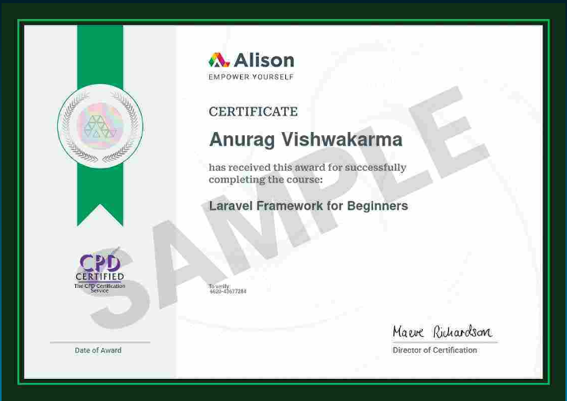

Slide 7
Thank You

